Slide 1
Lighthouses
©Elinor DeWire

Slide 2
The United States has about 675 lighthouses!
Michigan has the most lighthouses-117!
Does your state have lighthouses?
Let’s learn about lighthouses!

Slide 3
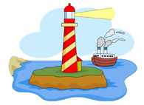
Why do ships need lighthouses?
Lighthouses help ships travel safely from sea to land.

Slide 4
The world has dangerous coasts. Ships can crash!
Dangers:
—shallow water
—rocks
—fog
—storms
Arrrh maties! Ships need lighthouses!

Slide 5
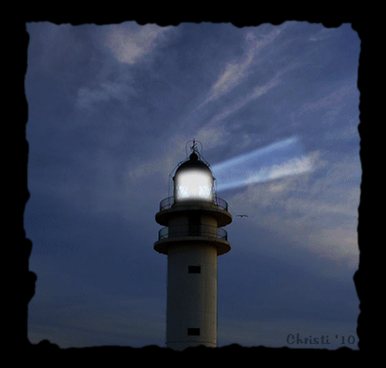
Let’s look at lighthouses! They come in all shapes, sizes, and colors.

Slide 6
Some are BIG and TALL.

Slide 7
Some are short and small.

Slide 8
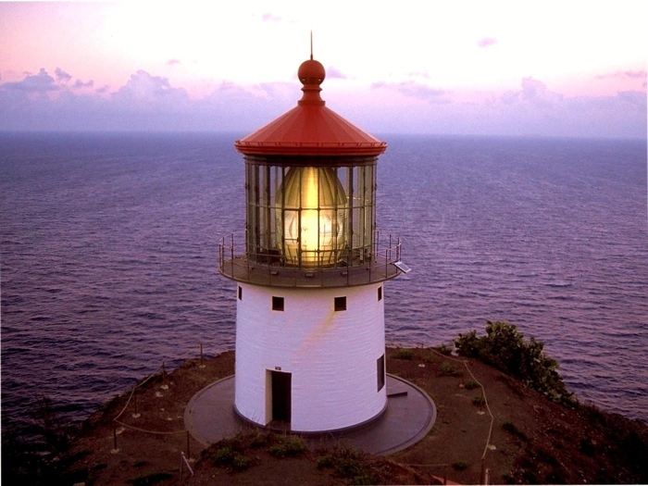
Some are round.

Slide 9
Some are square.

Slide 10
Some are bright.

Slide 11
Some are not so bright.

Slide 12
Some are plump.

Slide 13
Some are skinny.

Slide 14
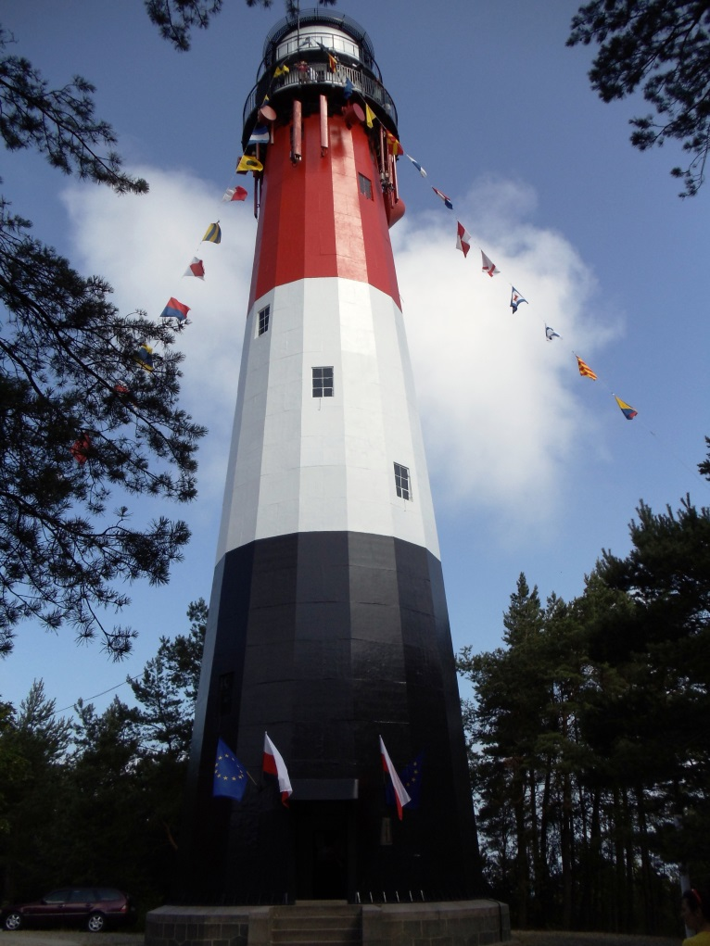
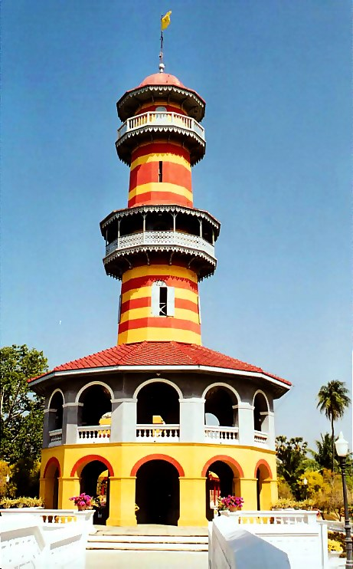
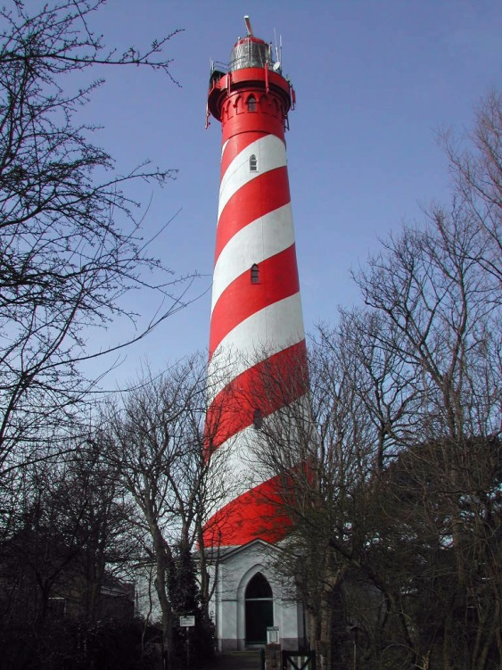
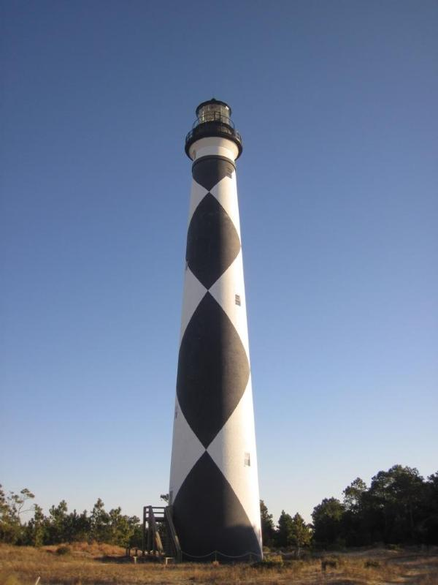
Some are colorful and fancy!

Slide 15
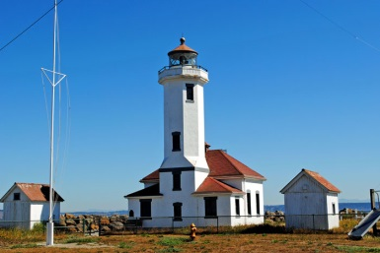
Some stand on land.

Slide 16
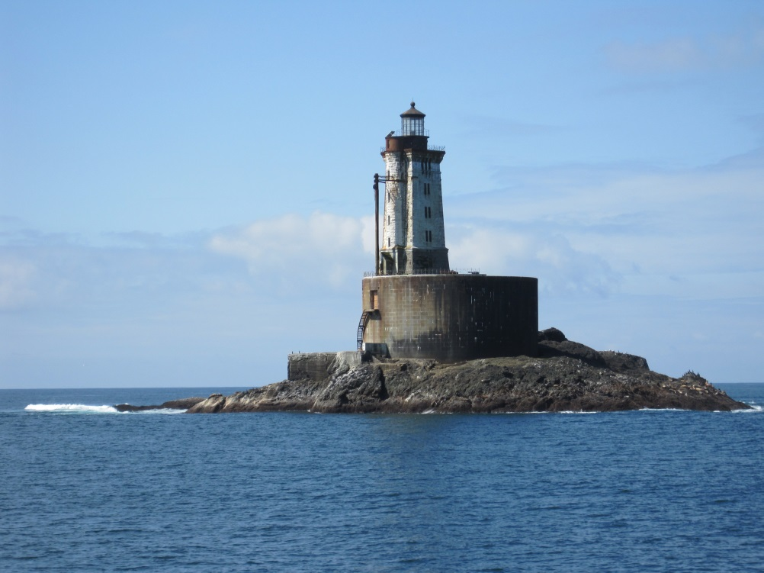
Some stand on rocks and islands.

Slide 17
Some stand in the water.

Slide 18
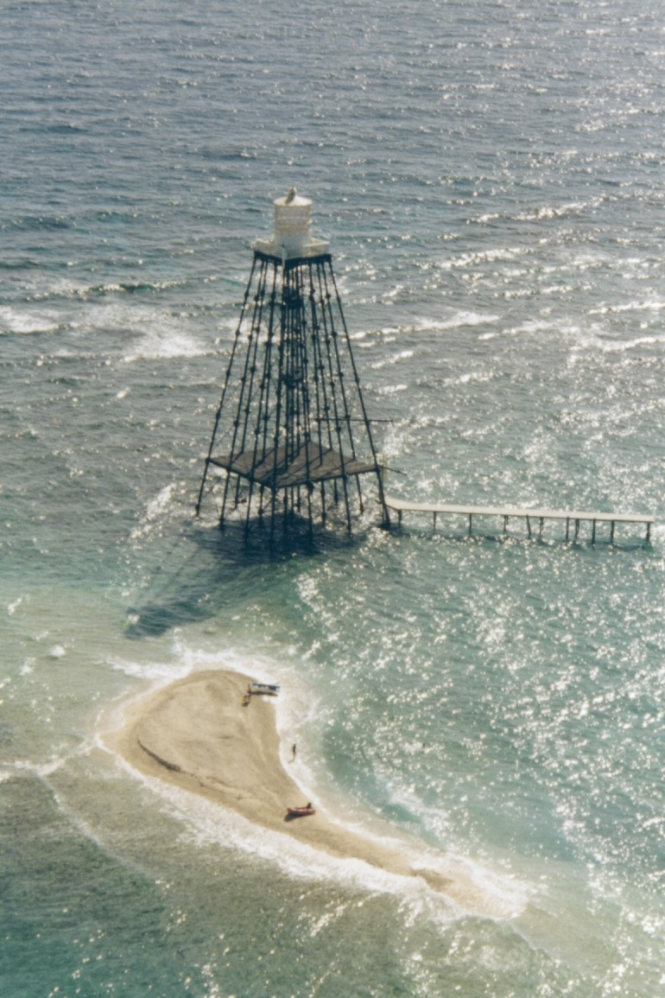
Some have thin iron legs!

Slide 19
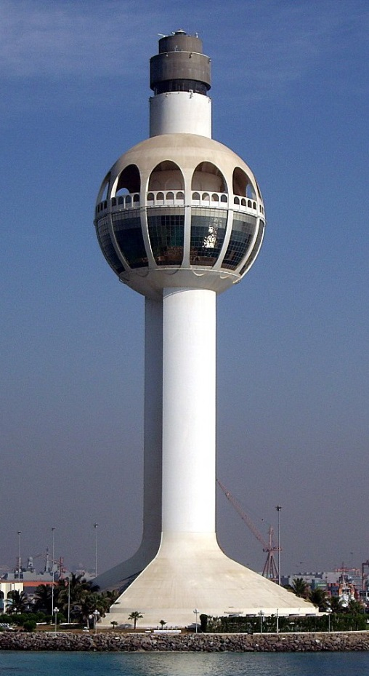
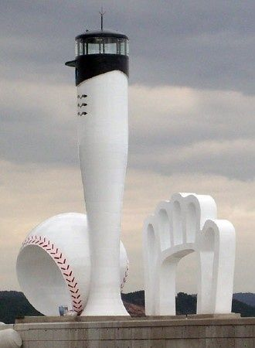
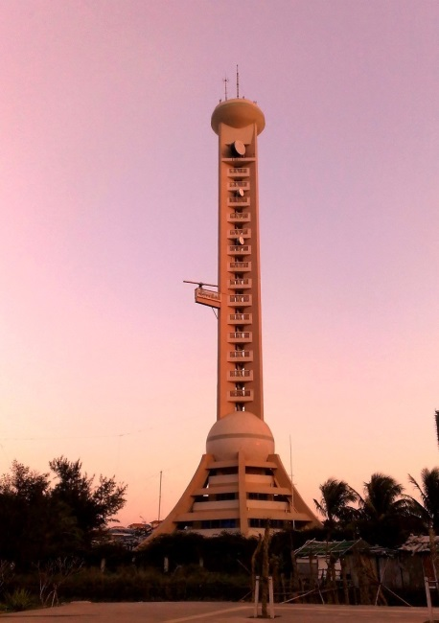
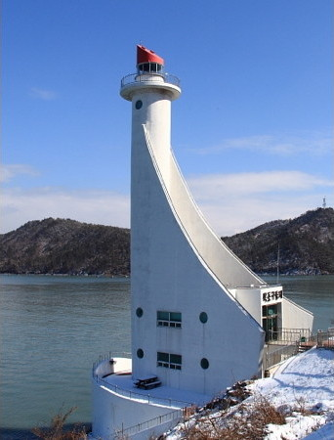
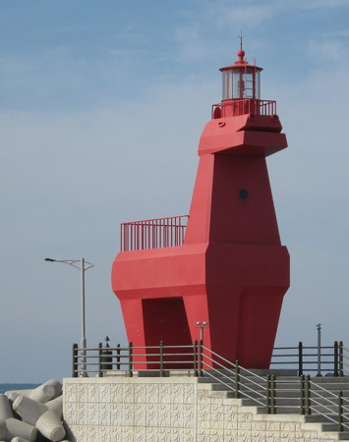
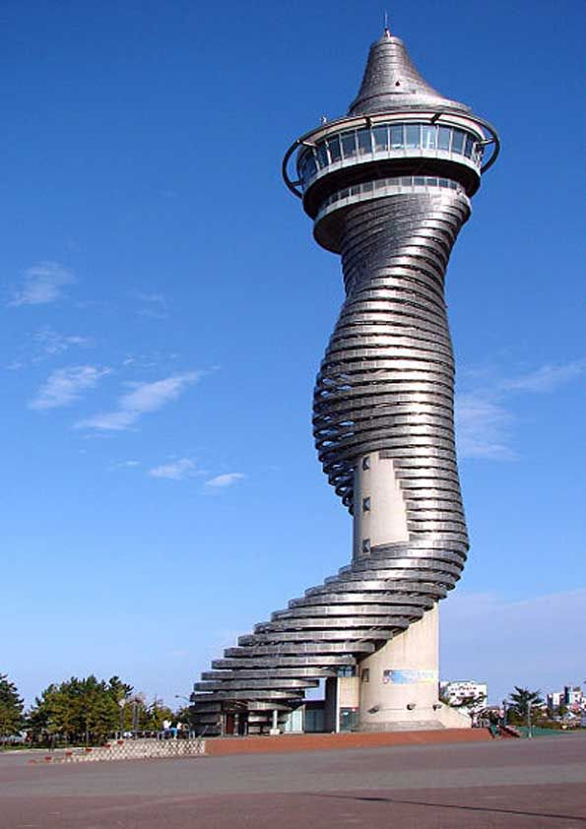
Some have funny shapes!

Slide 20
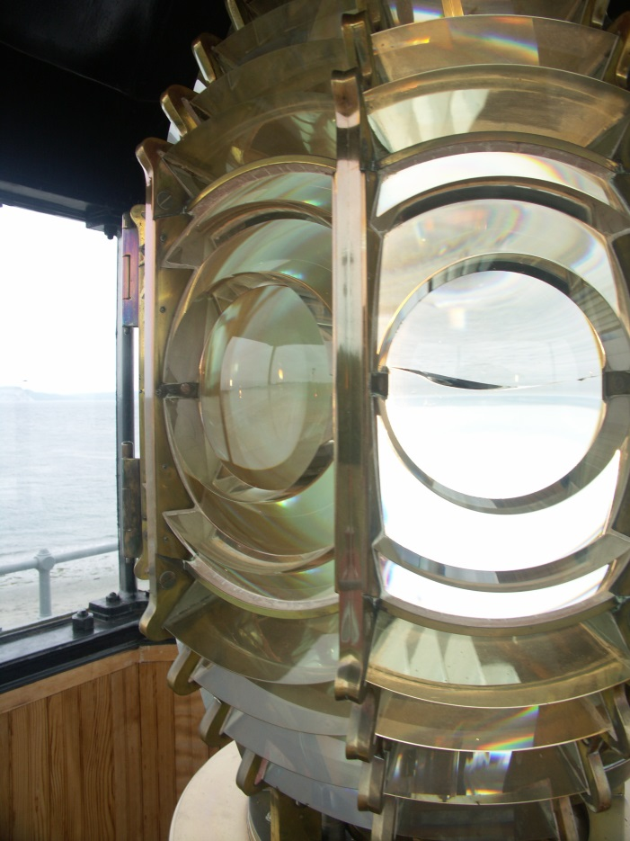
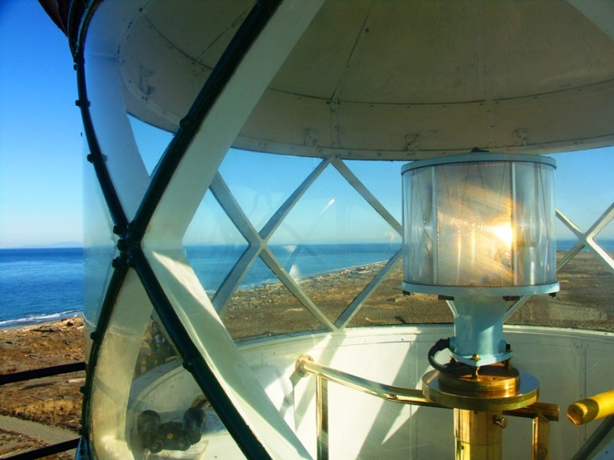
Lighthouses have lights. Lenses make the lights powerful.

Slide 21
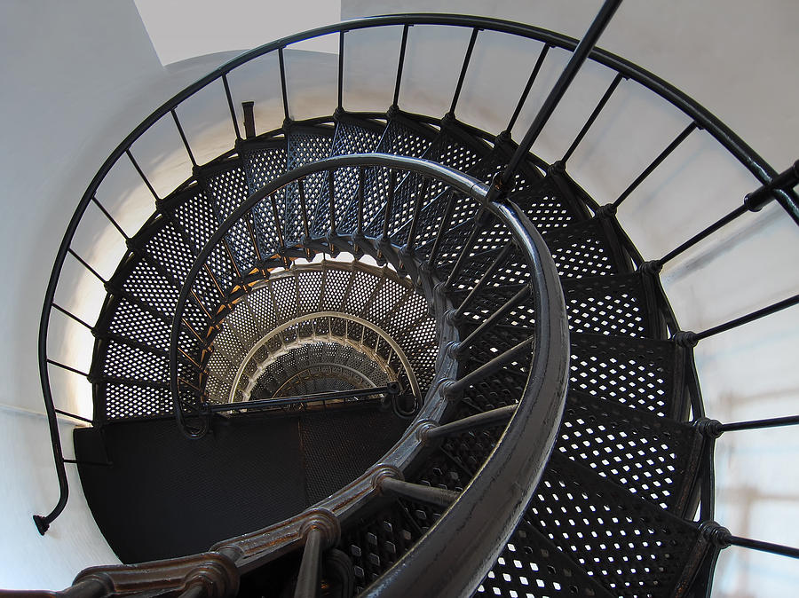
Lighthouse have big stairways!
The stairs go up, up, up and around and around to the top of the lighthouse.

Slide 22
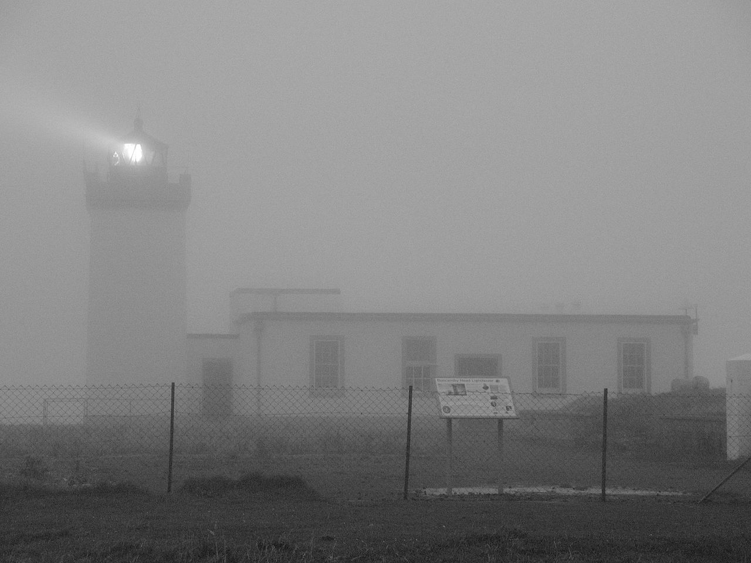
Lighthouses have fog signals. Bells, horns, sirens, whistles!
NOISE!!

Slide 23
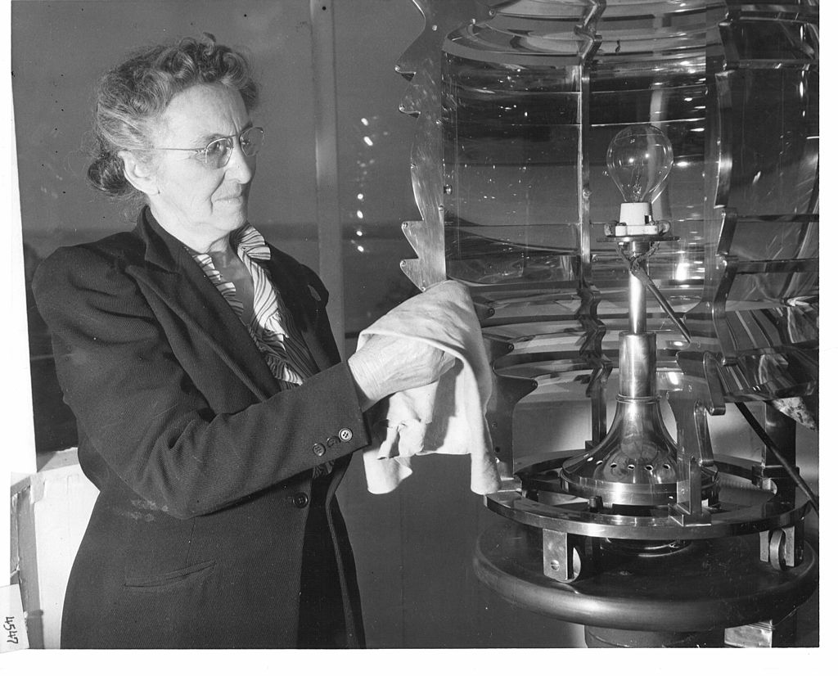
Many years ago, lighthouses had keepers to turn the lights on and off.

Slide 24
Lighthouse keepers had families.

Slide 25
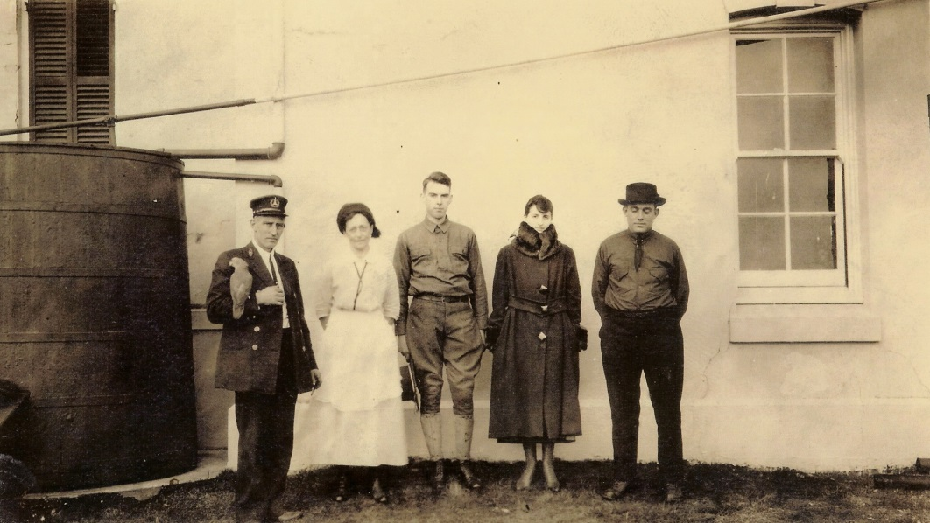
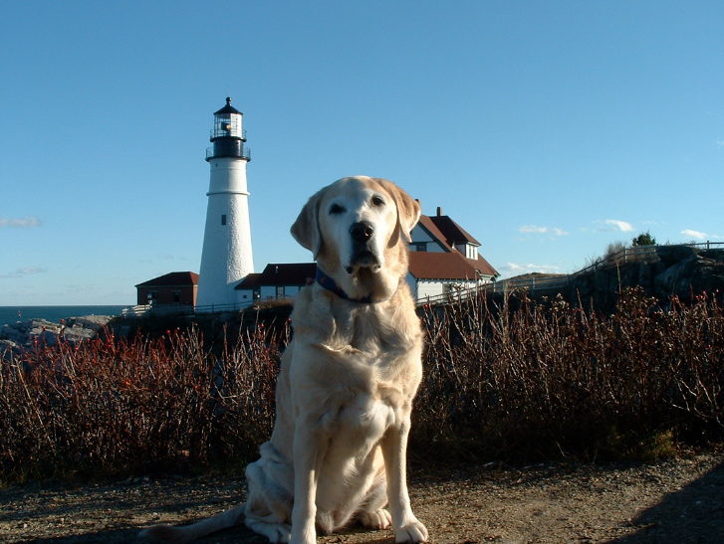
Lighthouse keepers had pets too!

Slide 26
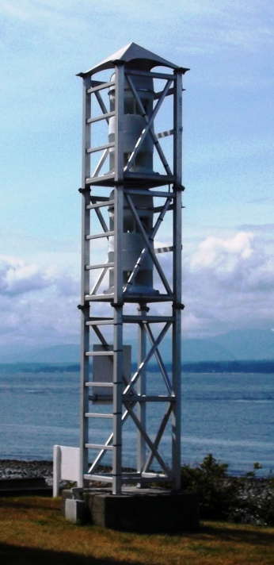
Modern lighthouses don’t need keepers. They run automatically.
Lights switch themselves on and off. They are powered by the sun.
Fog signals also turn on and off on their own.

Slide 27
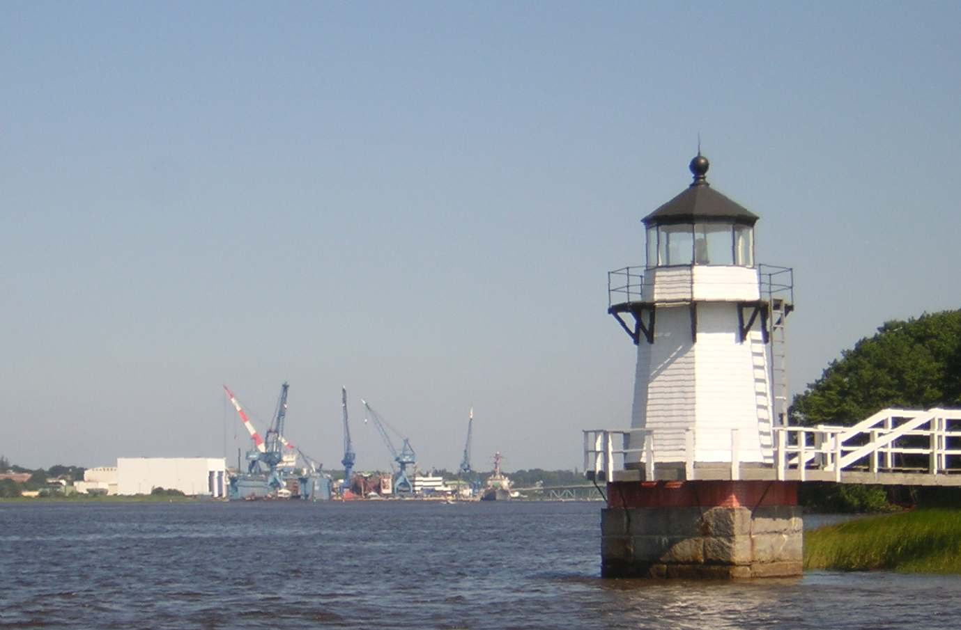
What did you learn?
Write down or tell three things that surprised you!
Look for books in the library about lighthouses!
Draw a lighthouse.
Write a lighthouse story or poem.

Slide 28
The End!

